Slide 1
META ADS STRATEGY
Replay
Menswear
Newbridge, Co. Kildare · replaymenswear.ie · 2026

Slide 2
CONTEXT
Where We Start
IN PLACE
STARTING POINT
THE OPPORTUNITY
Existing Strengths
What We're Working With
Why This Can Work
Shopify store live — replaymenswear.ie
100+ years of local reputation in Newbridge
Premium brands: Carhartt, Tommy Jeans, CK, Dickies, Farah
Free shipping over €69 — strong conversion hook
Physical store: Whitewater Shopping Centre
Facebook page: 0 followers
No pixel data — clean slate
No existing ad creative
Brand images available (same as every competitor)
Phase 1 budget: €500/month (scaling to €1,000)
Kildare market underserved for premium menswear online
Strong brands drive search intent — Meta can intercept
Interest-based targeting drives early traffic while pixel learns
Local trust + premium brand access = unique positioning

Slide 3
Messaging
Framework

Slide 4
WHAT THE ADS SAY
Positioning & Messaging
CORE POSITIONING "The brands you know. The shop you can trust."
STAGE | GOAL | MESSAGE ANGLE | EXAMPLE COPY
COLD | Brand awareness | Legitimacy + curation | "Carhartt. Tommy Jeans. Dickies. All in one place. Free shipping over €69."
COLD | Seasonal intent | New arrivals + freshness | "New season just landed in Newbridge. Tommy Jeans, Carhartt, Farah."
WARM | Consideration | Trust + convenience | "Still thinking about it? Free shipping on orders over €69 — easy returns."
HOT | Retargeting | Urgency + specific product | "You were looking at this. Only a few left — order today for free shipping."

Slide 5
Campaign
Structure

Slide 6
THE ROADMAP
The 3-Phase Approach
PHASE 01 · Months 1-2
PHASE 02 · Months 3-4
PHASE 03 · Month 5+
Launch & Learn
Optimise & Retarget
Scale on Proof
One CBO campaign with a single ad set containing 3-5 diverse creatives. This consolidates all budget into one learning pool — at €500/month, splitting across ad sets starves each of data. Interest-based targeting optimised for Add to Cart.
Retargeting activates when visitor pool hits 500-1,000. Advantage+ Shopping campaigns launch here — the pixel now has data. Lookalike audiences launch once purchase events exceed 100.
Budget increases in controlled 20% increments every 5-7 days. Never increase spend on a hunch. Target ROAS 2.5-3.5x. Begin national expansion once local ROAS is proven.
Gate to Phase 2: 500+ site visitors in pixel pool and 15+ purchase events.
Gate to Phase 3: ROAS 2.0x+ for 3+ consecutive weeks, cost-per-purchase stabilising within 20% week-on-week.
Budget ceiling: €1,000/month when Phase 2 criteria are met.
CTR
CPC
Sessions
Pixel Events
ROAS
Cost/Purchase
Add-to-Cart
Revenue
Scaling Efficiency
Frequency

Slide 7
BUDGET & ALLOCATION
Budget & Scaling Logic
Phase | Monthly Ad Spend | Budget Split | Target ROAS | Expected Revenue
Phase 1 · Months 1-2 | €500 | 1 CBO / 1 ad set / 3-5 creatives (ATC) €350 · Broad €100 · Engagement €50 | 0.5-1.0x (learning) | Not the measure. Pixel learning is.
Phase 2 · Months 3-4 | €500 | Advantage+ Shopping €250 · Retargeting €150 · Interest winners €100 | 1.5-2.5x | €750-€1,250/month
Phase 3 · Month 5+ | €750-€1,000 | Proportional scaling of winners. Kill losers. | 2.5-3.5x | €2,500-€3,500/month
SCALING TRIGGERS (all required) ROAS 2.0x+ for 3 consecutive weeks · Cost-per-purchase within 20% WoW · 15+ purchase events · Frequency < 3.5
WHY ADD TO CART FIRST At €500/month, optimising for Purchase keeps ad sets stuck in learning phase — you need ~50 events/week/ad set. Add to Cart happens 3-5x more often, giving the algorithm signal to learn.

Slide 8
OPERATING RULES
Campaign Management Rules
1 CBO · 1 AD SET · 3-5 DIVERSE CREATIVES
CREATIVE DIVERSITY = TARGETING
At €500/month (~€16.50/day), splitting budget across multiple ad sets starves each one of data — they stay stuck in Limited Learning. Consolidate into one ad set with 3-5 creatives. Let Meta decide which gets spend. If a creative shows €0 spend, replace it — Meta considers it too similar.
Meta's Andromeda algorithm matches ads to users via creative signals, not demographics. If your ads all look the same, Meta compresses your reach. Every ad must be materially different: static, UGC, carousel, text-heavy, lifestyle.
DISABLE AI ENHANCEMENTS
TRACK MER, NOT JUST PLATFORM ROAS
Meta turns on Advantage+ Creative without consent — replacing your brand images with AI-generated content. Check every campaign 2-3x per week. Ensure Advantage+ Creative is OFF. Takes 10 minutes, prevents brand damage.
Marketing Efficiency Ratio = total Shopify revenue / total ad spend. At €500/month, Meta's reported ROAS sample sizes are too small to be meaningful. MER gives you the business-level truth. Benchmark against Shopify revenue, not Ads Manager.
THE OFFER MATTERS MORE THAN THE STRUCTURE Test at least 2-3 offers: free shipping threshold (€69), 10% first-order discount via email, gift-with-purchase on orders over €100. The right offer moves the needle more than any account setup.

Slide 9
Content
& Creative

Slide 10
CREATIVE PRODUCTION
Content Sources & Formats
The single highest-value investment right now: a 60-minute in-store phone shoot. This will outperform brand-supplied images within weeks.
Brand-Supplied Images
Carousel Ads
Calvin Klein, Tommy Jeans, Carhartt — high quality. Caveat: every competitor has the same images. Use as a starting point only.
'Shop the Look' — brand images assembled in Canva. Each card tells part of a story. Drives higher engagement and multi-product discovery.
Canva / Zeely Graphics
Phone Video (Reels)
Generate ad format variations quickly. Seasonal offers, free shipping announcements, brand spotlights. Good for maintaining creative freshness.
Staff on camera: 'Just got these in...' Casual, authentic, first-person. Consistently outperforms polished creative. Low effort, high returns.

Slide 11
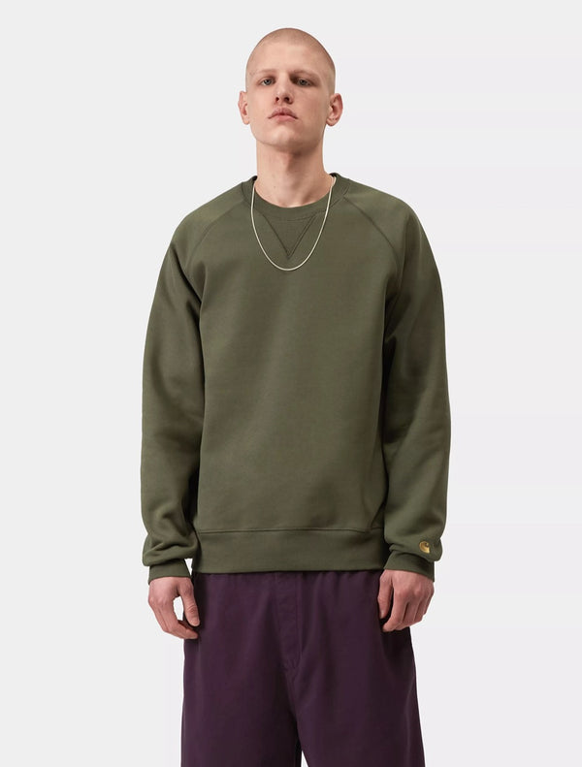
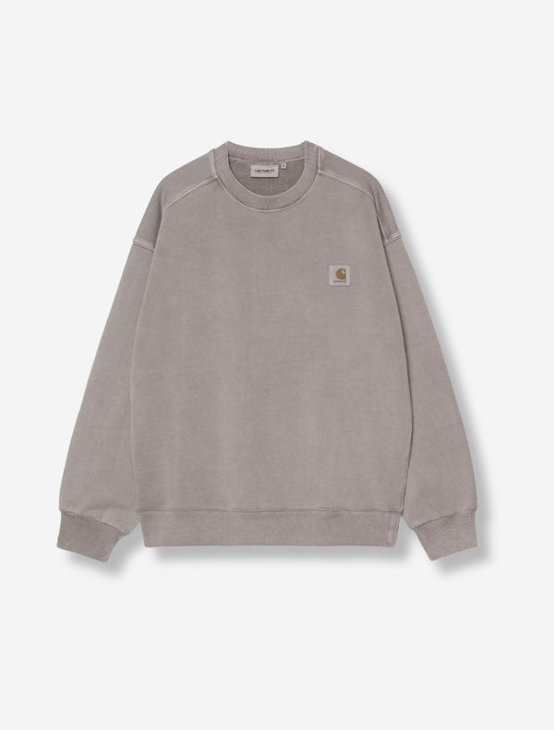
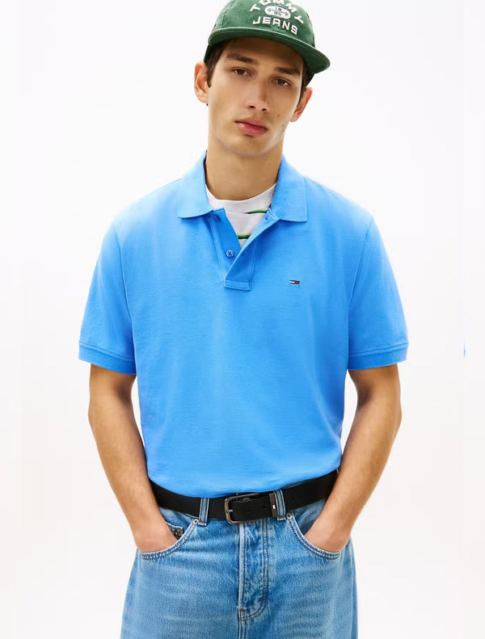
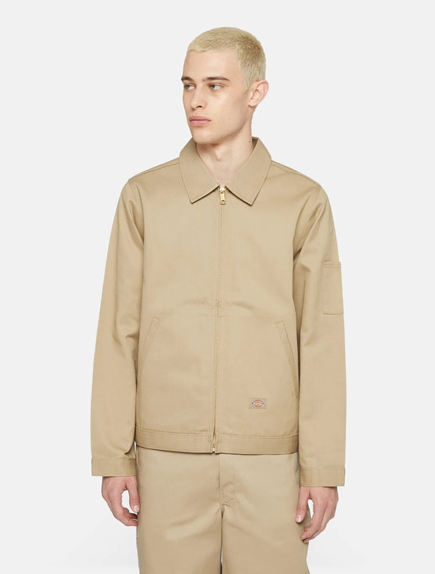
CREATIVE FORMATS
Ad Format Examples
01 — SINGLE IMAGE FEED AD
02 — CAROUSEL: MULTI-BRAND
RM
Replay Menswear
Sponsored
RM
Replay Menswear
Sponsored
Carhartt WIP. Tommy Jeans. Calvin Klein.
All under one roof in Newbridge.
Free shipping on orders over €69
New season just dropped. Carhartt WIP,
Tommy Jeans, Dickies — all in one place.
Free shipping over €69.
→
See All
Carhartt Nelson
Tommy Jeans Polo
Dickies Eisenhower
€120
€70
€85
replaymenswear.ie
Shop Now
Carhartt WIP Chase Sweatshirt — €80

Slide 12
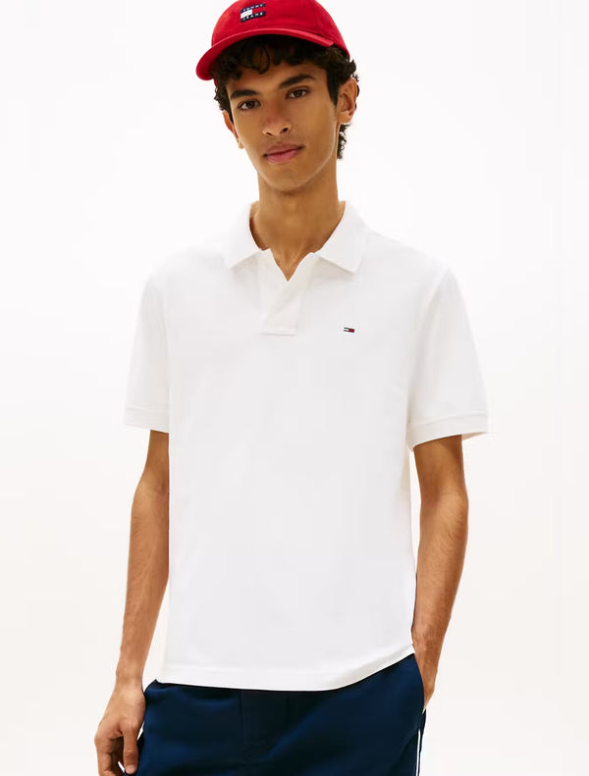
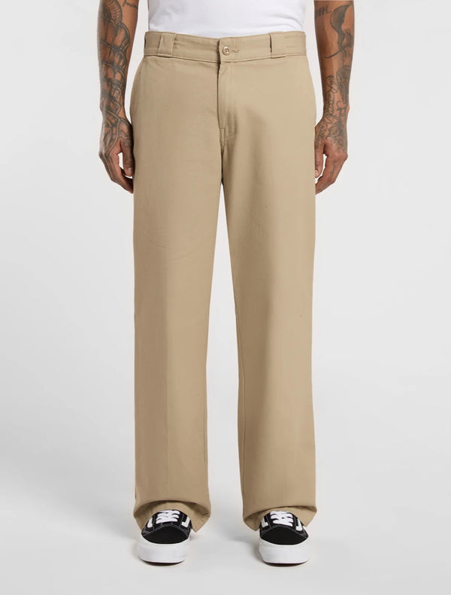
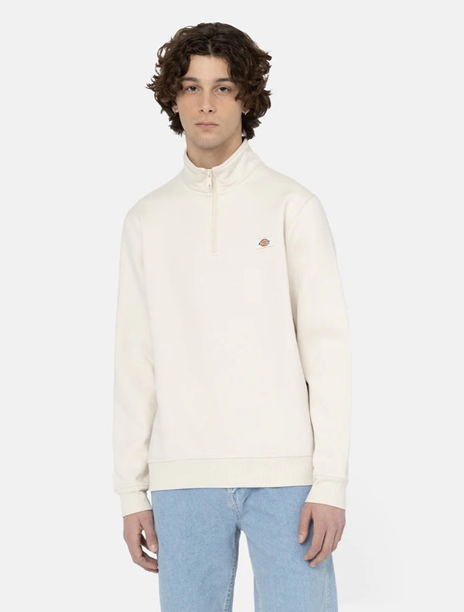
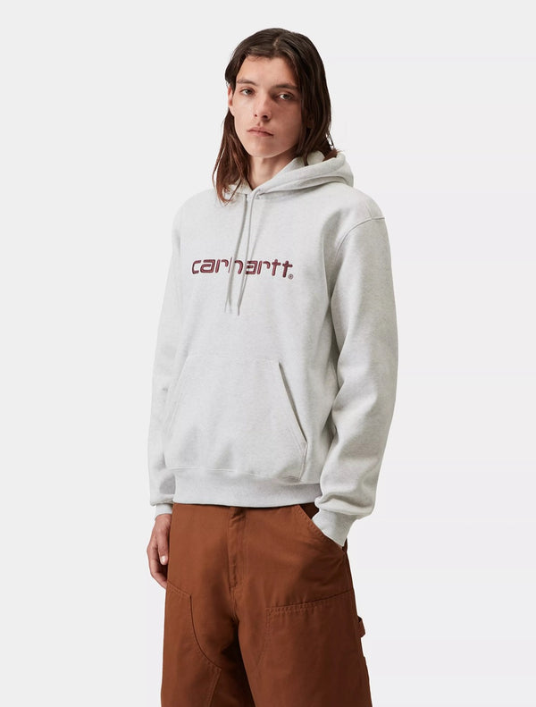
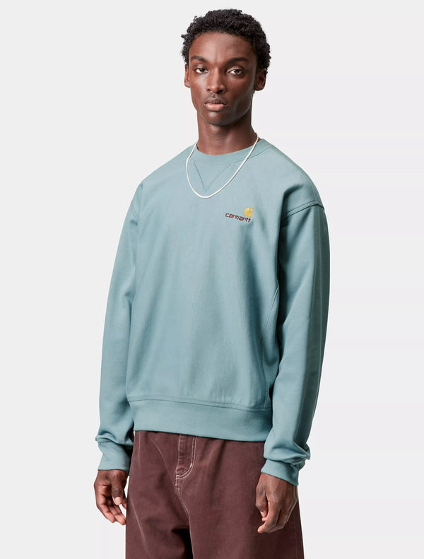
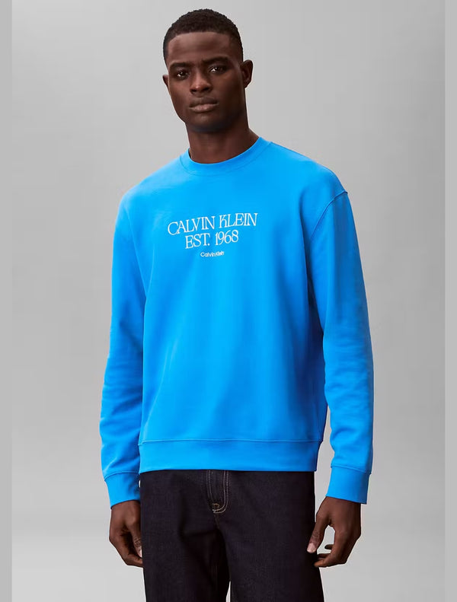
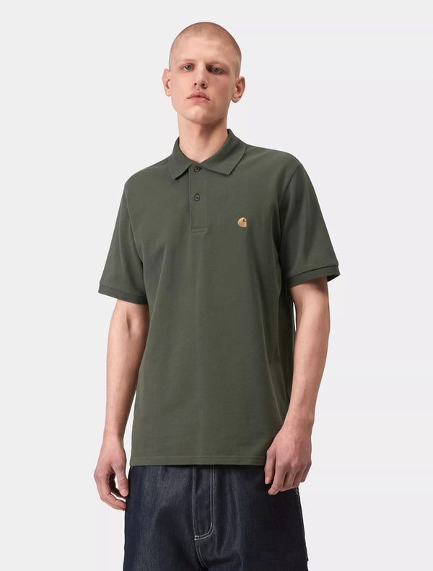
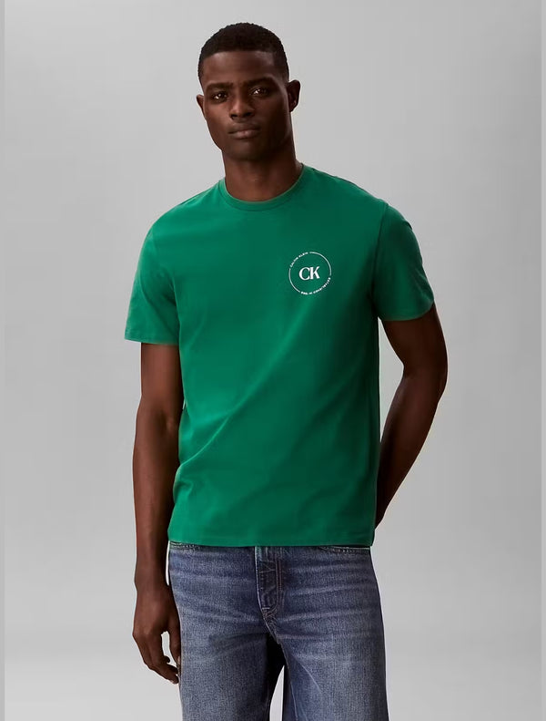
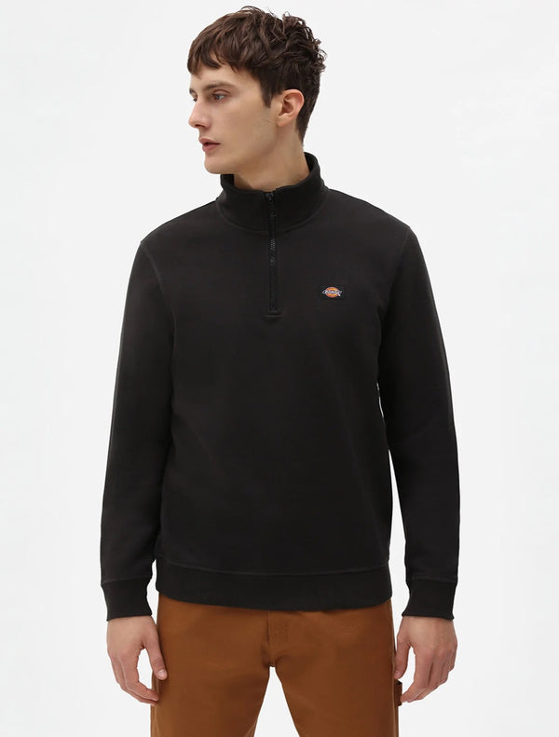
CREATIVE FORMATS (CONTINUED)
03 — CAROUSEL: SHOP THE LOOK
04 — STORY / REEL
FULL LOOK
€189
for all three
THE POLO
THE TROUSER
THE LAYER
Shop the Look
NEW SEASON
Tommy Jeans Polo
Dickies 247 Trousers
Dickies Oakport ¼ Zip
Carhartt WIP
Hooded Sweatshirt
€70
€50
€69
€100
9:16 Vertical · IG Reels + FB Video
05 — COLLECTION AD
06 — DYNAMIC RETARGETING (PHASE 2)
In Stock
Still thinking about it?
CK NYC Graphic Sweatshirt — €80
Free shipping over €69. Easy returns.
Chase Polo
CK Graphic Tee
Oakport ¼ Zip
€55
€40
€69
Complete Your Order

Slide 13
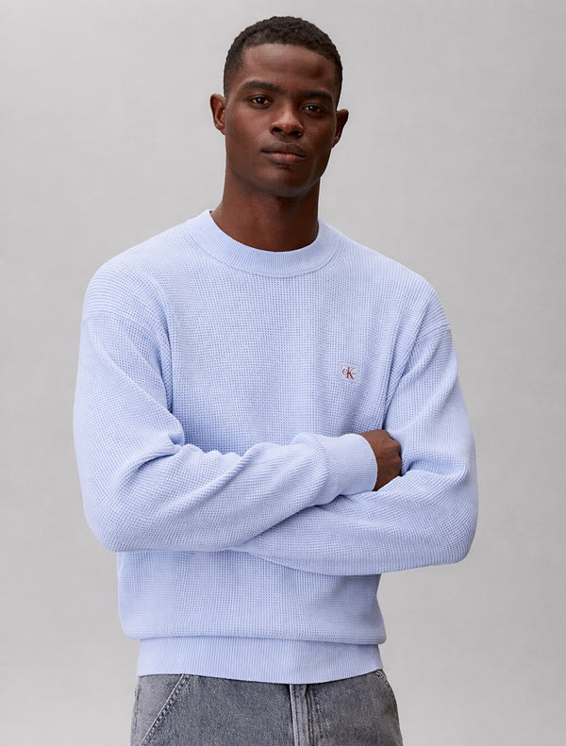
DESIGNED CREATIVES
Canva / Photoshop Ad Examples
Graphics designed for the feed — bold text overlays, brand colours, promotional messaging. Produce these in Week 2 alongside the phone shoot.
07 — SEASONAL PROMOTION
08 — MULTI-BRAND SPOTLIGHT
REPLAY MENSWEAR · NEWBRIDGE
NEW SEASON 2026
The brands you know.
The shop you can trust.
Carhartt
WIP
Carhartt WIP
Tommy Jeans
Premium menswear.
Newbridge, Co. Kildare.
From €50
From €30
Shop Now
Dickies
Calvin Klein
From €29
From €30
Free shipping over €69 · replaymenswear.ie
FREE SHIPPING OVER €69 → SHOP THE COLLECTION

Slide 14
DIAGNOSTICS
Reading the Data
Five signals to watch weekly — and what each one means for your next move.
Signal | What It Means
CTR < 0.8% | Creative problem. The hook isn't earning the click. Pause and launch a new creative with a different lead image.
Good CTR, no purchases | NOT an ads problem. People click but don't buy. Audit Shopify funnel: mobile speed, checkout flow, product page.
CPM > €22 | Audience too narrow for budget. Broaden geo by 15km or loosen interest targeting.
Frequency > 3.5 | Audience saturation. Same people seeing the same ad too often. Introduce new creative and expand audience.
ATC > 3%, purchase < 1% | Cart abandonment. Activate retargeting earlier and audit checkout UX for unexpected friction.
KILL CRITERIA Pause any creative with CTR below 0.8% after 500+ impressions and 48+ hours running. Do not pause earlier — the data is too thin to be meaningful.

Slide 15
Email &
Owned
Audience

Slide 16
OWNED AUDIENCE
Email Capture Strategy
Meta builds the pixel. Email is the asset you own permanently, regardless of what the algorithm does.
Recommended Setup
Automation Sequences
Tool | Purpose
Klaviyo (Shopify) | Email + SMS list management, automations
Shopify popup | 10% off first order in exchange for email
Checkout opt-in | Default-on email opt-in at checkout
Meta Lead Ads | Email capture directly within Meta — Month 2+
Sequence | Trigger | Goal
Welcome flow | Email sign-up | Introduce + redeem discount
Abandoned cart | ATC, no purchase 1hr | Recover sale — free shipping
Post-purchase | First purchase | Thank you + review request
Win-back | No purchase 90 days | New arrivals + seasonal offer

Slide 17
Seasonal
Calendar

Slide 18
TIMING STRATEGY
Seasonal Campaign Calendar
When | Priority | Event | Campaign Angle
Mar-May | High | Spring / New Season | Lightweight jackets, chinos, polos. "Spring edit just landed."
June | Medium | Father's Day | Gift buyer segment (women 28-50). "The brands he actually wears."
September | High | Wardrobe Reset | "New season. Update the wardrobe." Natural buying moment.
Oct-Nov | High | Pre-Christmas | Build awareness before Black Friday noise.
Late Nov | High | Black Friday / Cyber Monday | Budget +30-40% if Phase 2 met. Peak conversion week.
December | High | Christmas Gifting | Women shopping for men. "Still looking for him?"
January | Medium | New Year / Sales | Clearance + "New year, new wardrobe." Low CPMs = testing window.
BUDGET TIMING — Increase budget 20-30% during Black Friday and Christmas (Phase 2 criteria must be met first).

Slide 19
Platforms &
Performance

Slide 20
MEASURING SUCCESS
KPIs by Phase
Phase 1 · Months 1-2 · Learning Metrics
CPM
CTR
CPC
Sessions/mo
Email Captures
€8-18
> 1.5%
< €0.80
500+
50+
Phase 2 · Months 3-4 · Performance Metrics
ROAS
Cost/Purchase
Add-to-Cart
Retarget CTR
AOV
1.5-2.5x
€12-20
> 3%
> 2.5%
Track
Phase 3 · Month 5+ · Scale Metrics
ROAS
Revenue
Pixel Events
Frequency
Cost/Purchase
2.5x+
↑ MoM
50+/wk
< 3.5
Stable

Slide 21
IF THINGS AREN'T WORKING
Contingency Protocol
Signal | Diagnosis | Action
CTR below 0.8% | Creative problem. Hook not working. | Test a new hook — 2 new variants with different lead images.
CPM above €22 | Audience too narrow for budget. | Widen audience — expand geo by 15km or loosen interests.
Good CTR, no purchases | NOT an ads problem. Website/checkout friction. | Audit funnel — mobile speed, checkout UX, add-to-cart rate.
Frequency above 3.5 | Audience saturation. Same ad too often. | Refresh creative + expand — 2 new variants + 2% lookalike.
ROAS flat at month 4 | Product-market fit or creative issue. | Structured review — test 10% first order, review hero products.

Slide 22
LAUNCH CHECKLIST
30-Day Quick Start
WEEK 1
WEEK 2
WEEK 3
WEEK 4
Technical Setup
Creative Production
Build & Launch
First Data Review
Install Meta Pixel on Shopify
Enable Conversions API (server-side)
Set up Meta Business Manager
Configure 5 pixel events
Build custom audiences
Install Klaviyo + email popup
Select 10-12 brand images
60-min in-store phone shoot
4 ad variants: 2 static, 2 video
3 copy variations + free shipping
Identify 8-10 hero products
Build 2 carousel ads in Canva
Build interest-based ATC campaign
Set broad prospecting campaign
Add engagement campaign
Configure UTM tracking
Test-purchase from store
Launch — no changes for 5 days
Review day-7 performance
Pause creative with CTR < 0.8%
Increase budget on winners
Verify all pixel events firing
Check email captures
Month 1 report to client

Slide 23
SUMMARY
Strategy at a Glance
Campaigns | 1 CBO / 1 ad set / 3-5 creatives (ATC) Phase 1. ASC Phase 2.
Platforms | Facebook + Instagram from day one. TikTok deferred Month 5+.
Content | Creative diversity: static, UGC, carousel, text-heavy. Every ad materially different.
Stock | Category ads default. Product ads only with 25+ units.
Message | "The brands you know. The shop you can trust." Free shipping on every ad.
Email | Klaviyo day one. 10% first-order popup. Abandoned cart automation.
Retargeting | Activated Month 2 when visitor pool hits 500-1,000.
Scaling | Budget increases only when ROAS > 2.0x for 3+ weeks.
THE 5 THINGS THAT WILL DETERMINE SUCCESS
1. Creative diversity — every ad materially different. Mix static, UGC, carousels, text-heavy. This IS your targeting now.
2. Free shipping messaging — feature it on every ad, every stage.
3. MER over ROAS — track total Shopify revenue / total ad spend. Platform ROAS is unreliable at this budget.
4. Offers beat structure — test 2-3 offers (free shipping, 10% first order, gift-with-purchase). The right offer moves the needle more than any setup.
5. Disable AI enhancements — check 2-3x per week. Meta turns them on without consent.
IMMEDIATE NEXT STEPS
Week 1: Technical setup — pixel, CAPI, Klaviyo, disable AI enhancements
Week 2: Phone shoot + 4 diverse creatives (static, UGC, carousel, text)
Week 3: Launch 1 CBO / 1 ad set / 3-5 creatives (ATC). Monday, 72hr wait.
Month 2: Switch to Purchase opt. Test retargeting when pool hits 500.
Month 3: Activate ASC with proven winners. Test lookalikes.

Slide 24
Replay Menswear
Meta Ads Strategy 2026
Prepared by Thomas Kelly · March 2026 · Confidential

